Slide 1

Neural Networks and Deep Learning(18CSE23)
(B.E (CSE) VII-Sem PE-V)
Unit-II Presentation on
Supervised Learning Neural Networks
By
Dr. Kolla Morarjee
Associate Professor, Department of CSE
Chaitanya Bharathi Institute of Technology, Hyderabad

Slide 2
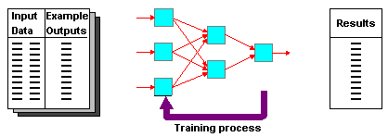
DEFINITION OF SUPERVISED LEARNING NETWORKS
  Training and test data sets
  Training set; input & target are specified

Slide 3
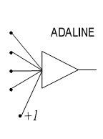
ADAPTIVE LINEAR NEURON (ADALINE)
In 1959, Bernard Widrow and Marcian Hoff of Stanford developed models they called ADALINE (Adaptive Linear Neuron) and MADALINE (Multilayer ADALINE). These models were named for their use of Multiple ADAptive LINear Elements. MADALINE was the first neural network to be applied to a real world problem. It is an adaptive filter which eliminates echoes on phone lines.

Slide 4
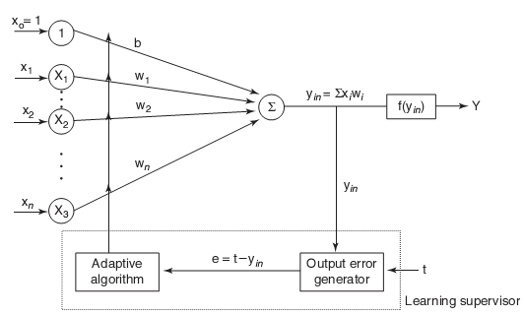
ADALINE MODEL

Slide 5
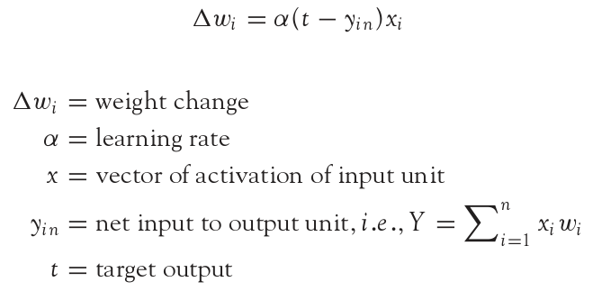
ADALINE LEARNING RULE
Adaline network uses Delta Learning Rule. This rule is also called as Widrow Learning Rule or Least Mean Square Rule. The delta rule for adjusting the weights is given as (i = 1 to n):

Slide 6
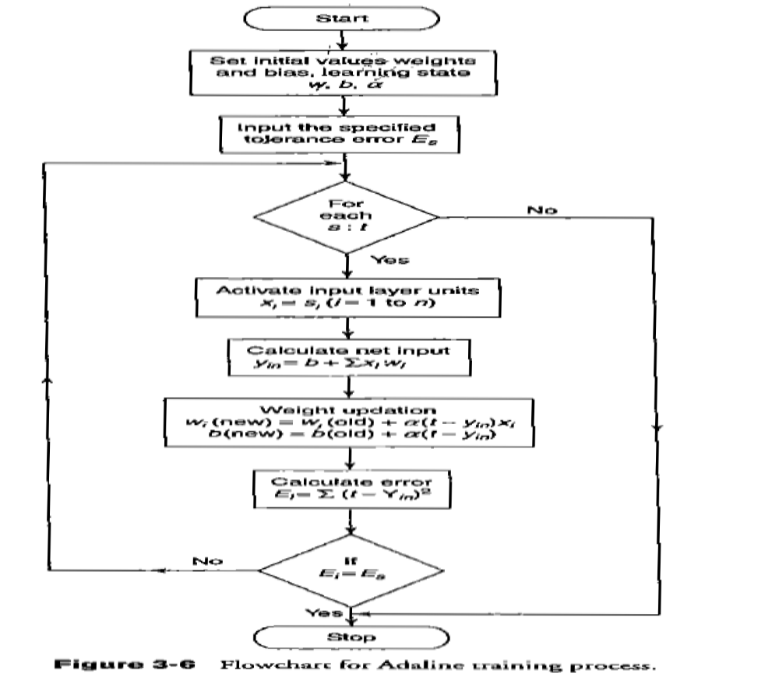
ADALINE TRAINING PROCESS

Slide 7
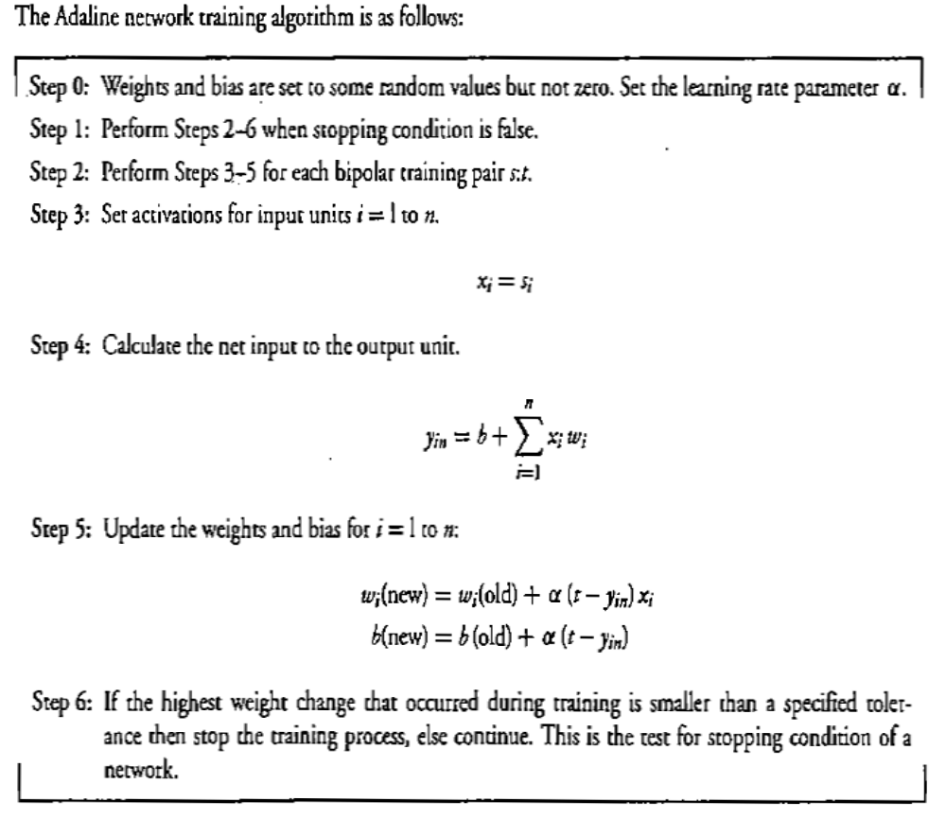
ADALINE TRAINING ALGORITHM

Slide 8
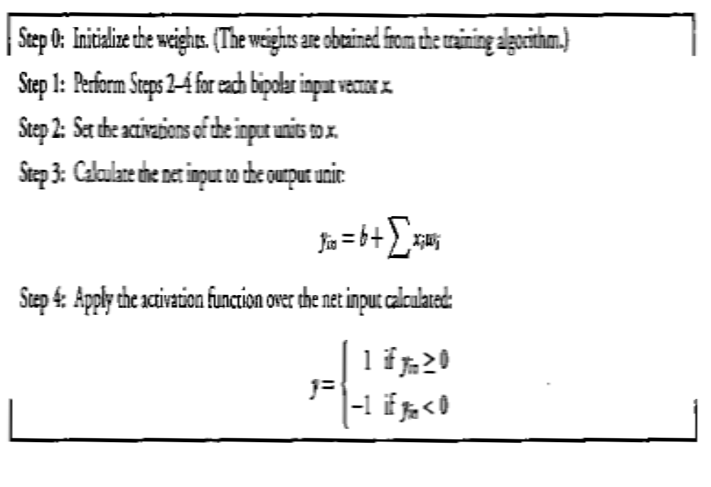
ADALINE TESTING ALGORITHM

Slide 9
USING ADALINE NETWORKS
Initialize
Assign random weights to all links
Training
  Feed-in known inputs in random sequence
  Simulate the network
  Compute error between the input and the output (Error Function)
  Adjust weights (Learning Function)
  Repeat until total error < ε
Thinking
  Simulate the network
  Network will respond to any input
  Does not guarantee a correct solution even for trained inputs
Initialize
Training
Thinking

Slide 10
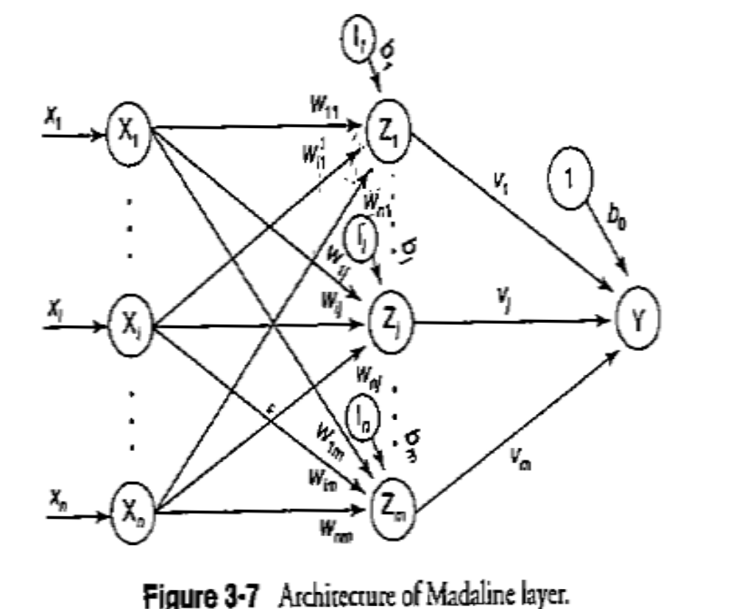
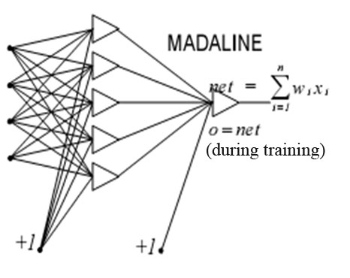
MADALINE NETWORK
MADALINE is a Multilayer Adaptive Linear Element. MADALINE was the first neural network to be applied to a real world problem. It is used in several adaptive filtering process.

Slide 11
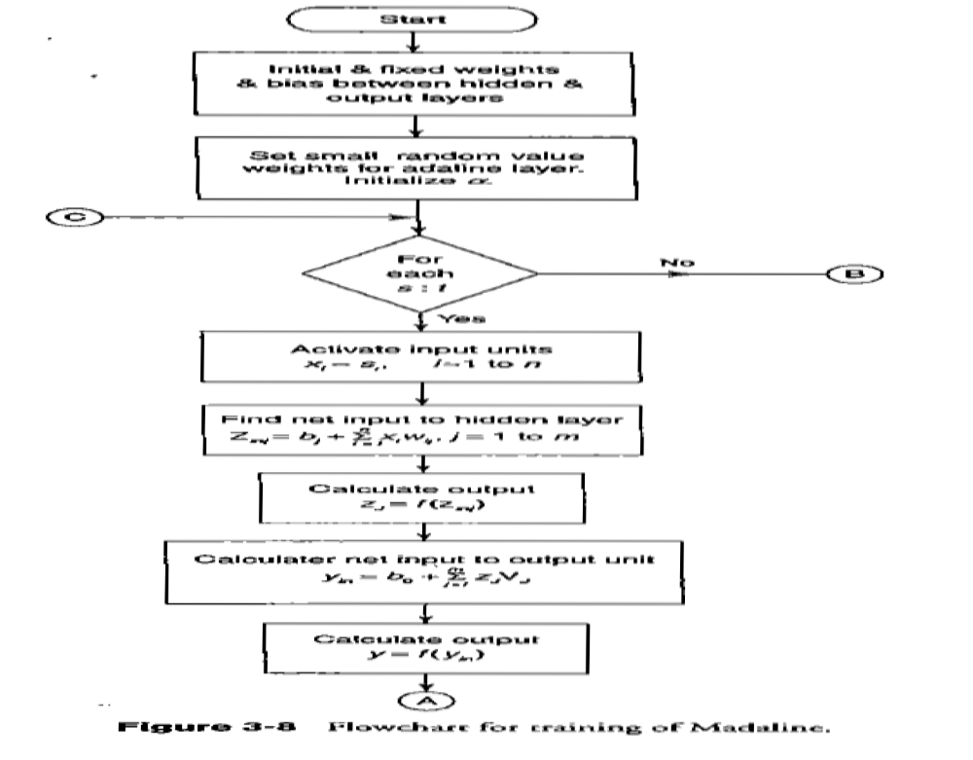
MADALINE TRAINING PROCESS

Slide 12
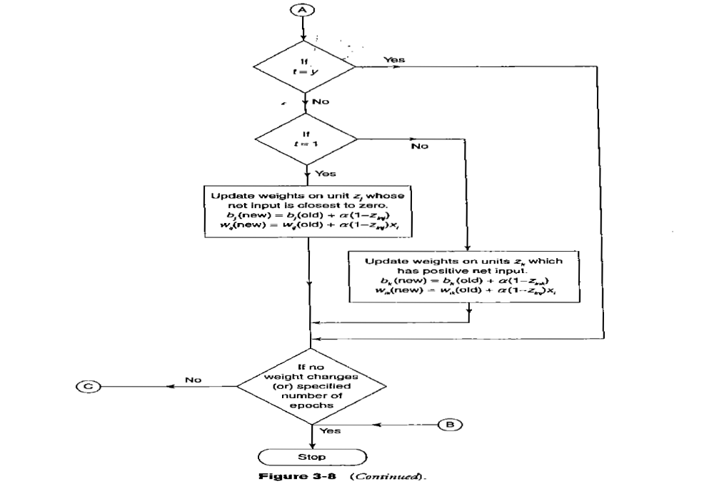
MADALINE TRAINING PROCESS…

Slide 13
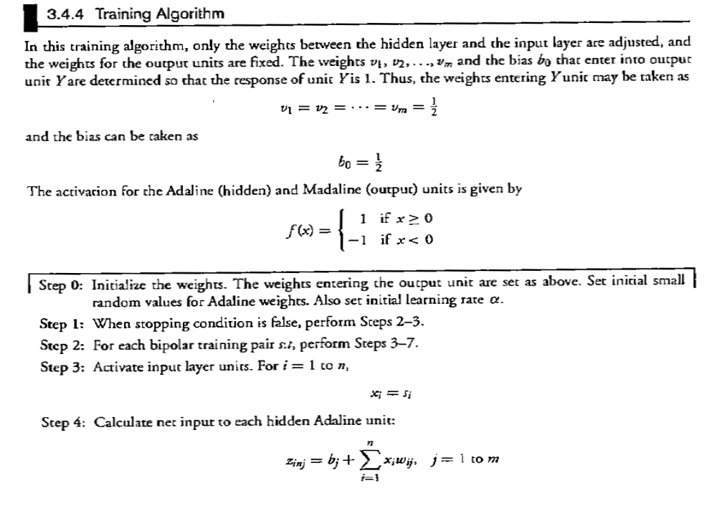
MADALINE TRAINING ALGORITHM

Slide 14
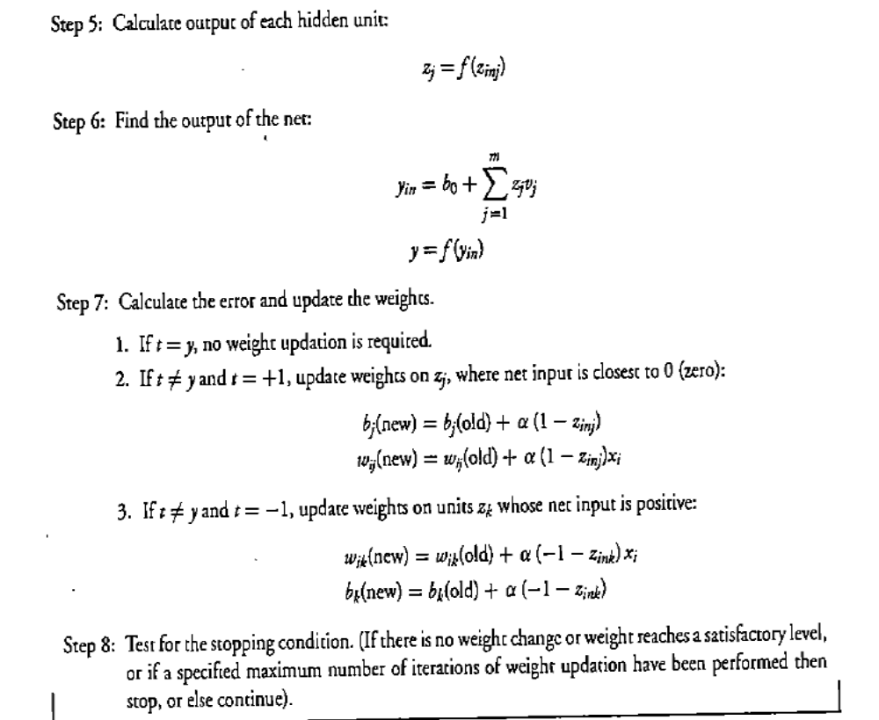
MADALINE TRAINING ALGORITHM…

Slide 15
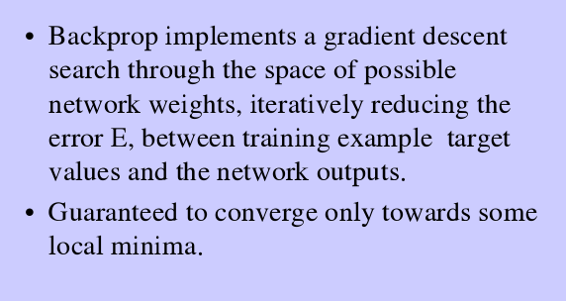

Slide 16
A training procedure which allows multilayer feed forward Neural Networks to be trained.
Can theoretically perform “any” input-output mapping.
Can learn to solve linearly inseparable problems.

Slide 17
MULTILAYER FEEDFORWARD NETWORK
Inputs
Hiddens
I₀
Outputs
h₀
I₁
o₀
h₁
I₂
o₁
h₂
Outputs
I₃
Hiddens
Inputs

Slide 18
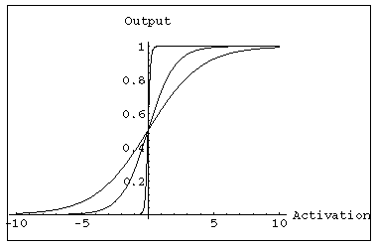
MULTILAYER FEEDFORWARD NETWORK:
ACTIVATION AND TRAINING
For feed forward networks:
  A continuous function can be
  differentiated allowing
  gradient-descent.
  Back propagation is an example of a gradient-descent technique.
  Uses sigmoid (binary or bipolar) activation function.

Slide 19
In multilayer networks, the activation function is
usually more complex than just a threshold function,
like 1/[1+exp(-x)] or even 2/[1+exp(-x)] – 1 to allow for
inhibition, etc.

Slide 20
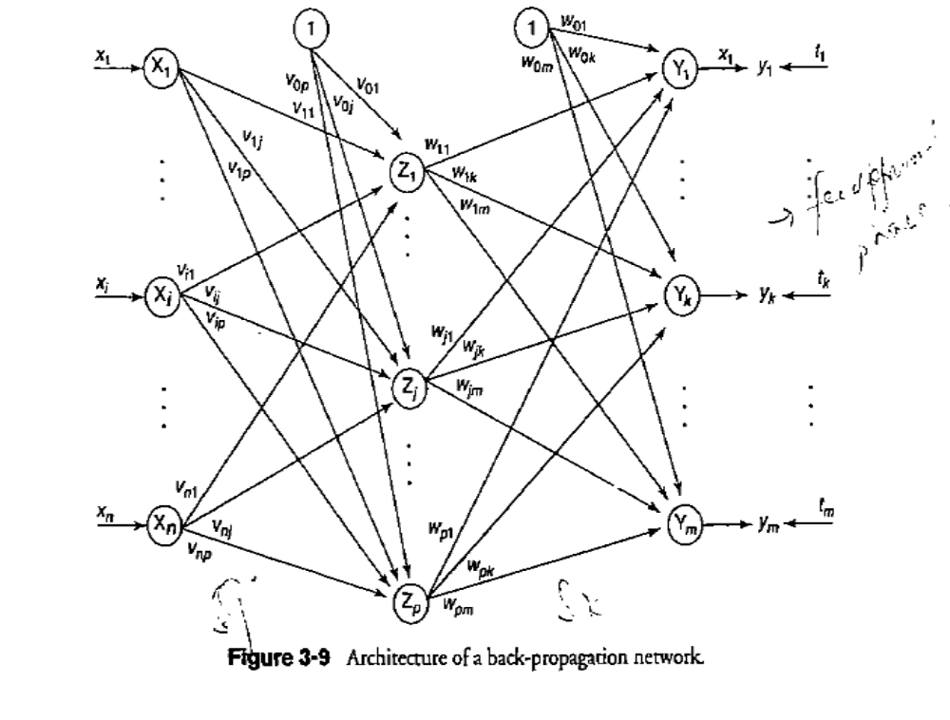
BACK PROPAGATION NETWORK

Slide 21
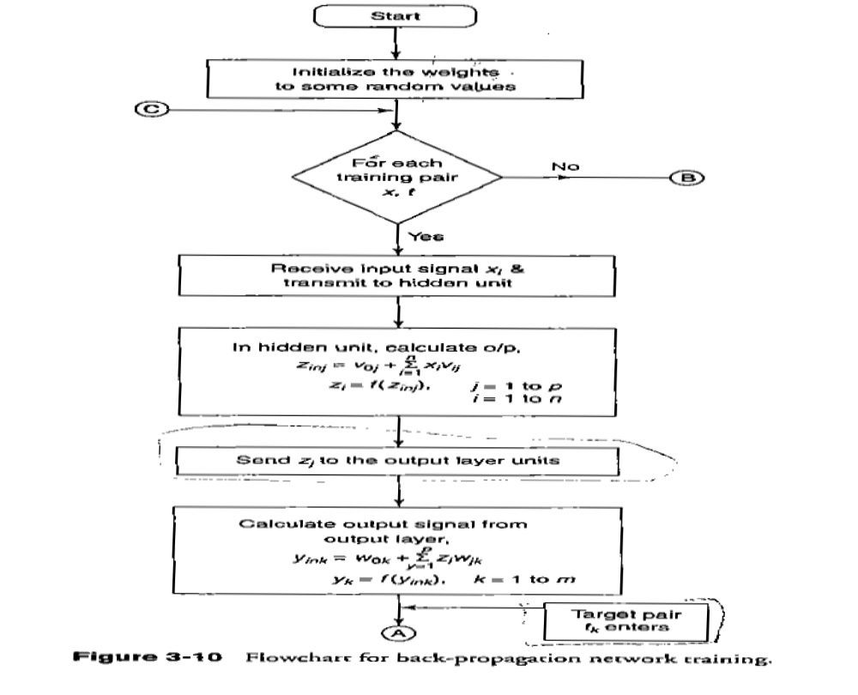
FLOW CHART FOR BACK PROPAGATION NETWORK TRAINING

Slide 22
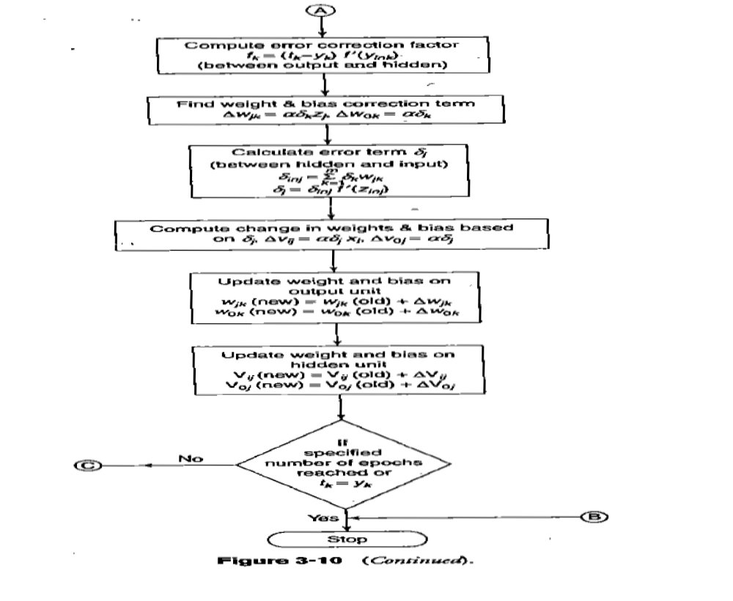
FLOW CHART FOR BACK PROPAGATION NETWORK TRAINING…

Slide 23

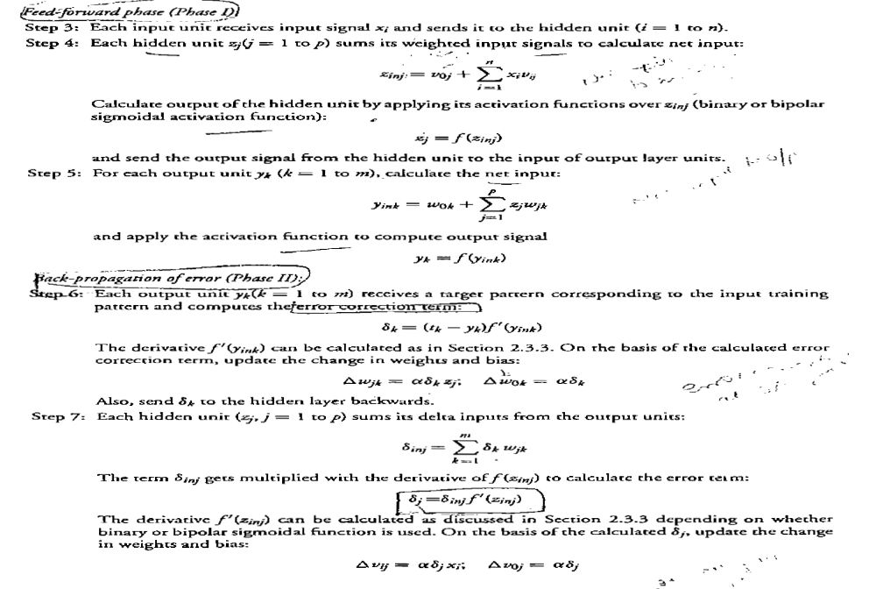
BACK PROPAGATION TRAINING ALGORITHM

Slide 24
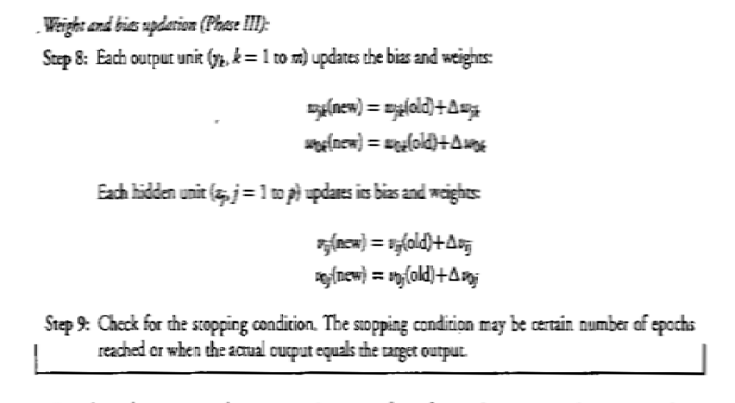
BACK PROPAGATION TRAINING ALGORITHM…

Slide 25
LEARNING FACTORS OF BACK PROPAGATION NETWORK
Initial Weights
Learning Rate
Momentum Factor
Generalization
Number of Training Data
Number of Hidden Layer Nodes

Slide 26
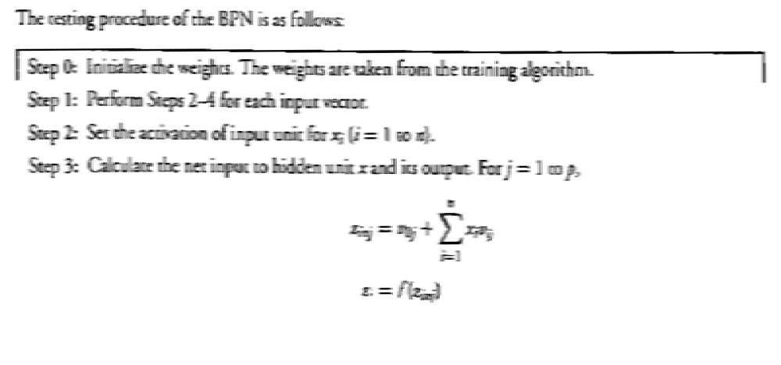

BACK PROPAGATION TESTING ALGORITHM

Slide 27
GRADIENT DESCENT
Gradient-Descent(training_examples, η)
Each training example is a pair of the form <(x₁,…x_{n}),t> where (x₁,…,x_{n}) is the vector of input values, and t is the target output value, η is the learning rate (e.g. 0.1)
Initialize each wi to some small random value
Until the termination condition is met, Do
  Initialize each Δwi to zero
  For each <(x₁,…x_{n}),t> in training_examples Do

Slide 28
    Input the instance (x1,…,xn) to the linear unit and compute the output o
    For each linear unit weight wi Do
  Δw_{i}= Δw_{i} + η (t-o) xi
  For each linear unit weight wi Do
  w_{i}=w_{i}+Δw_{i}

Slide 29
MODES OF GRADIENT DESCENT
Batch mode : gradient descent
w=w - η ∇ED[w] over the entire data D
ED[w]=1/2Σd(t_{d}-o_{d})2
Incremental mode: gradient descent
w=w - η ∇E_{d}[w] over individual training examples d
Ed[w]=1/2 (t_{d}-o_{d})2
Incremental Gradient Descent can approximate Batch Gradient Descent arbitrarily closely if η is small enough.

Slide 30
SIGMOID ACTIVATION FUNCTION
x₀₌₁
x₁
w₁
w₀
net=Σ_{i=0}^{n} w_{i} x_{i}
o=σ(net)=1/(1+e^{-net})
w₂
x₂
Σ
o
.
.
.
w_{n}
σ(x) is the sigmoid function: 1/(1+e-x)
dσ(x)/dx= σ(x) (1- σ(x))
x_{n}
Derive gradient decent rules to train:
one sigmoid function
∂E/∂w_{i} = -Σd(td-od) od (1-od) xi
Multilayer networks of sigmoid units backpropagation

Slide 31
BACKPROPAGATION TRAINING ALGORITHM
Initialize each wi to some small random value.
Until the termination condition is met, Do
  For each training example <(x1,…xn),t> Do
    Input the instance (x1,…,xn) to the network and compute the network outputs ok
    For each output unit k
      δk=ok(1-ok)(tk-ok)
    For each hidden unit h
      δh=oh(1-oh) Σk wh,k δk
    For each network weight w,j Do
    wi,j=wi,j+Δwi,j where
      Δwi,j= η δj xi,j

Slide 32
BACKPROPAGATION
Gradient descent over entire network weight vector
Easily generalized to arbitrary directed graphs
Will find a local, not necessarily global error minimum -in practice often works well (can be invoked multiple times with different initial weights)
Often include weight momentum term
      Δwi,j(t)= η δj xi,j + α Δwi,j (t-1)
Minimizes error training examples
  Will it generalize well to unseen instances (over-fitting)?
Training can be slow typical 1000-10000 iterations (use Levenberg-Marquardt instead of gradient descent)

Slide 33
APPLICATIONS OF BACKPROPAGATION
NETWORK
Load forecasting problems in power systems.
Image processing.
Fault diagnosis and fault detection.
Gesture recognition, speech recognition.
Signature verification.
Bioinformatics.
Structural engineering design (civil).

Slide 34
Gradient Descent (GD),
Momentum Based GD,
Nesterov Accelerated GD,
Stochastic GD,
AdaGrad,
RMS Prop,
Adam,
http://ruder.io/optimizing-gradient-descent/
http://cs231n.github.io/neural-networks-3/
https://towardsdatascience.com/optimizers-for-training-neural-network-59450d71caf6
https://serokell.io/blog/ml-optimization
https://www.kdnuggets.com/2020/12/optimization-algorithms-neural-networks.html
https://www.deeplearningbook.org/contents/optimization.html

